Slide 1
Hibernia College Onsite Tutorial
Sessions 9 and 10

Slide 2
Session 9 : Counting and Probability
Counting
Multiplication Rule
Factorials
Choose Operators
Permutations - ordered subsets
Combinbations - how many ways
Probability
Independent Events
Axioms of Probability

Slide 3
Permutations
Permutations (full set of n items)
Number of permutations (no repetition) : n!
Set = A,B,C (3 items)
6 Permutations (3!)
ABC | BAC | CAB
ACB | BCA | CBA

Slide 4
Permutations
Permutations when repetition is allowed
Number of permuations n^{n}
Little practical use for this. not part of course

Slide 5
Permutations
Ordered subsets
k items selected from n items
Ordering is important
Number of permutations : n! / (n-r)!

Slide 6
Probability
Independent Events
First consider : Are events independent?
P(A and B) = P(A) x P(B)

Slide 7
Session 10 Matrices and Linear Equations
Matrices
Basic Matrix Operations
Scalar multiplication
Addition
Subtraction
Dimensions of a Matrix
Matrix Multiplication
Identity Matrix I

Slide 8
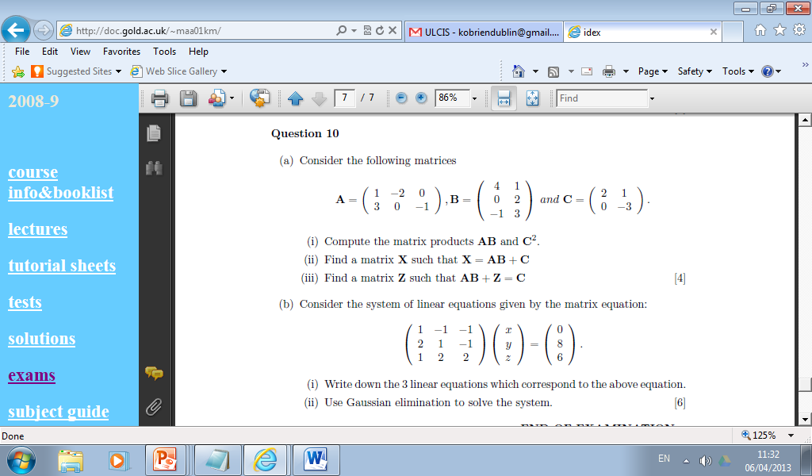

Slide 9
Session 10 Matrices and Linear Equations
Systems of Linear Equations
Using Matrices in Calculations
Augmented Matrices
Elementary Row Operations
Reduced Row form
Solutions for Systems

Slide 10
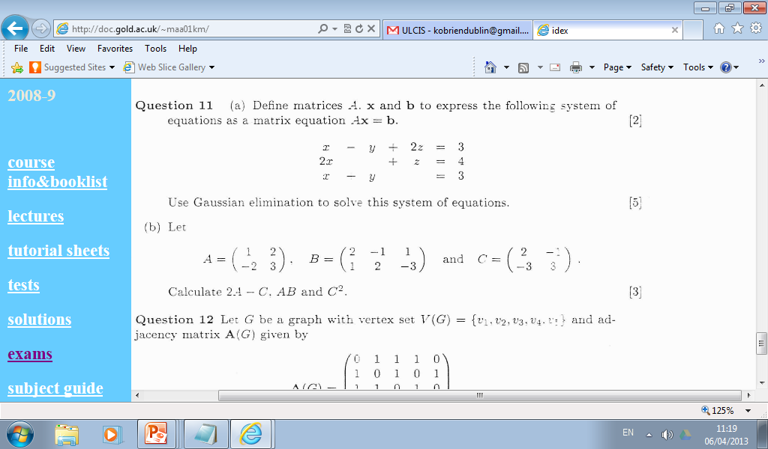

Slide 11
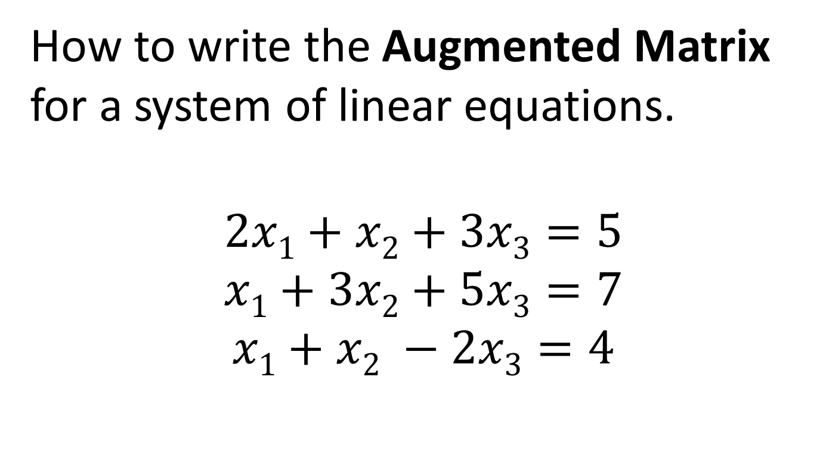
Augmented Matrix
How to write the Augmented Matrix for a system of linear equations.
$$\begin{matrix}2x1+x2+3x3=5 \\ x1+3x2+5x3=7 \\ x1+x2 −2x3=4\end{matrix}$$

Slide 12
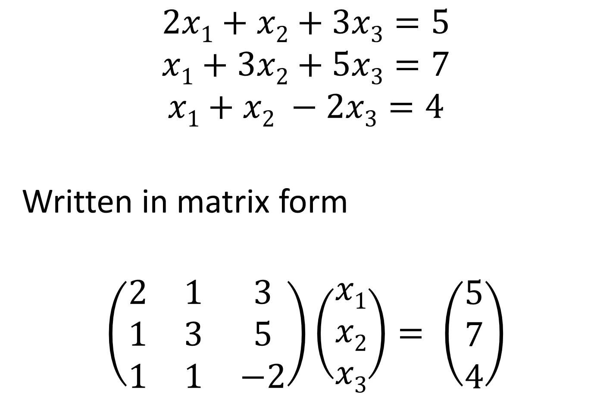
$$\begin{matrix}2x1+x2+3x3=5 \\ x1+3x2+5x3=7 \\ x1+x2 −2x3=4\end{matrix}$$
Written in matrix form
$$\left(\begin{matrix}2 & 1 & 3 \\ 1 & 3 & 5 \\ 1 & 1 & −2\end{matrix}\right)\left(\begin{matrix}x1 \\ x2 \\ x3\end{matrix}\right)= \left(\begin{matrix}5 \\ 7 \\ 4\end{matrix}\right)$$

Slide 13

$$\left(\begin{matrix}2 & 1 & 3 \\ 1 & 3 & 5 \\ 1 & 1 & −2\end{matrix}\right)\left(\begin{matrix}x1 \\ x2 \\ x3\end{matrix}\right)= \left(\begin{matrix}5 \\ 7 \\ 4\end{matrix}\right)$$
$$\left(\begin{matrix}2 & 1 & 3 \\ 1 & 3 & 5 \\ 1 & 1 & −2\end{matrix} \begin{matrix}⋮ & 5 \\ ⋮ & 7 \\ ⋮ & 4\end{matrix}\right)$$

Slide 14
Elementary Row Operations
(Operations are performed on rows only. Never perform any of these operations on columns.)
Multiply a row by a constant value
Switch the position of two rows
Add two rows together
Subtract one row from another.
Finish when matrix is in reduced echelon form

